Slide 1
Topics in Data Science
Cluster Analysis
Lecture 15

Slide 2
Machine Learning Types
Supervised Learning
Unsupervised Learning
Reinforcement Learning

Slide 3
Cluster Analysis
What is Cluster Analysis?
Partioning method(K-Means Clustering)
Hierarchical Clustering
Density-based Clustering
Proximity Measures

Slide 4
What Is Cluster Analysis?
Cluster: a collection of data objects
– Similar to one another within the same cluster
– Dissimilar to the objects in other clusters
Cluster analysis
– Grouping a set of data objects into clusters
Typical applications
– As a stand-alone tool to get insight into data distribution
– As a preprocessing step for other algorithms

Slide 5
Cluster Analysis-Unsupervised Learning
Given a set of objects (records), the goal of clustering or segmentation is to divide these objects into groups or “clusters” such that objects within a group tend to be more similar to one another as compared to objects belonging to different groups. In other words, clustering algorithms place similar points in the same cluster while placing dissimilar points in different clusters. Note that, in contrast to supervised tasks such as regression or classification where there is a notion of a target value or class label, the objects that form the inputs to a clustering procedure do not come with an associated target. Therefore, clustering is often referred to as unsupervised learning.
Unsupervised tasks such as clustering are also often used to explore and characterize the dataset before running a supervised learning task.

Slide 6
What is Cluster Analysis?
Finding groups of objects such that the objects in a group will be similar (or related) to one another and different from (or unrelated to) the objects in other groups
Inter-cluster distances are maximized
Intra-cluster distances are minimized

Slide 7
What is good clustering?
A good clustering method will produce high quality clusters with
– high intra-class similarity
– low inter-class similarity
The quality of a clustering result depends on both the similarity measure used by the method and its implementation.
The quality of a clustering method is also measured by its ability to discover some or all of the hidden patterns

Slide 8
Measure the Quality of Clustering
Dissimilarity/Similarity metric: Similarity is expressed in terms of a distance function, which is typically metric: d(i, j).
There is a separate “quality” function that measures the
“goodness” of a cluster.
The definitions of distance functions are usually very different for interval-scaled, boolean, categorical, and ordinal variables.
Weights should be associated with different variables based on applications and data semantics.
It is hard to define “similar enough” or “good enough”
– the answer is typically highly subjective.

Slide 9
Measure of Quality of Clustering
Partitioning criteria
Single level vs. hierarchical partitioning (often, multi-level hierarchical partitioning is desirable)
Separation of clusters
Exclusive (e.g., one customer belongs to only one region) vs. non-exclusive (e.g., one document may belong to more than one class)
Similarity measure
Distance-based (e.g., Euclidian) vs. connectivity-based (e.g., density)
Clustering space
Full space (often when low dimensional) vs. subspaces (often in high-dimensional clustering)

Slide 10
Applications of Clustering Analysis
Marketing: Help marketers discover distinct groups in their customer bases, and then use this knowledge to develop targeted marketing programs
Land use: Identification of areas of similar land use in an earth observation database
Insurance: Identifying groups of motor insurance policy holders with a high average claim cost
City-planning: Identifying groups of houses according to their house type, value, and geographical location

Slide 11
Major Clustering Approaches
Partitioning approach:
Construct various partitions and then evaluate them by some criterion
Typical methods: k-means, k-medoids, CLARANS (Clustering Large Applications based upon RANdomized Search)
Hierarchical approach:
Create a hierarchical decomposition of the set of data (or objects) using some criterion
Typical methods: Diana, Agnes, BIRCH, CAMELEON
Density-based approach:
Based on connectivity and density functions
Typical methods: DBSACN, OPTICS, DenClue
Grid-based approach:
based on a multiple-level granularity structure
Typical methods: STING, WaveCluster, CLIQUE

Slide 12
What is not Cluster Analysis?
Simple segmentation
Dividing students into different registration groups alphabetically, by last name
Results of a query
Groupings are a result of an external specification
Clustering is a grouping of objects based on the data
Supervised classification
Have class label information
Association Analysis
Local vs. global connections

Slide 13
Notion of a Cluster can be Ambiguous
How many clusters?
Six Clusters
Two Clusters
Four Clusters

Slide 14
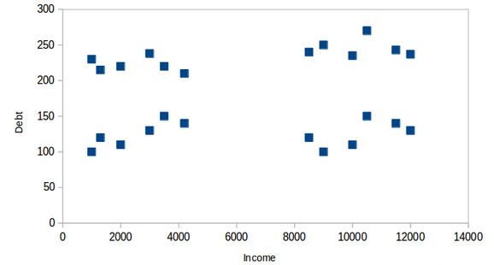
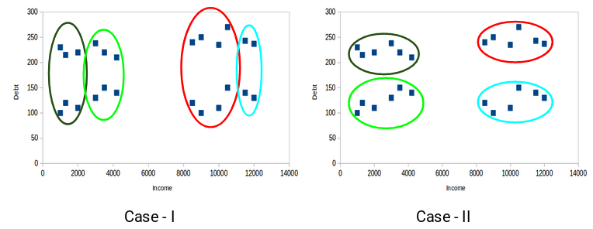
Example
How many clusters and what type of cluster?

Slide 15
Types of Clusterings
A clustering is a set of clusters
Important distinction between hierarchical and partitional sets of clusters
Partitional Clustering
A division of data objects into non-overlapping subsets (clusters) such that each data object is in exactly one subset
Hierarchical clustering
A set of nested clusters organized as a hierarchical tree

Slide 16
Partitional Clustering
Original Points
A Partitional Clustering

Slide 17
Hierarchical Clustering
Traditional Hierarchical Clustering
Traditional Dendrogram
Non-traditional Hierarchical Clustering
Non-traditional Dendrogram

Slide 18
Types of Data in Cluster Analysis
Clustering algorithms typically operate on either of the following two data structures:
–Data matrix
–Dissimilarity matrix

Slide 19
Data Matrix
A data matrix represents n objects, such as persons, with p variables(measurements or attributes), such as age, height, weight, gender, and so on.
The structure is in the form of a relational table, or n-by-p matrix

Slide 20
Dissimilarity Matrix
It is often represented by an n-by-n where d(i, j) is the measured difference or dissimilarity between objects i and j.
In general, d(i, j) is a nonnegative number that is close to 0 when objects i and j are highly similar or “near” each other becomes larger the more they differ
Where d(i, j)=d( j, i), and d(i, i)=0

Slide 21
Dissimilarity Calculation- Numerical Variables
The measurement unit used can affect the clustering Types of Data in Cluster Analysis
Expressing a variable in smaller units will lead to a
larger range for that variable, and thus a larger effect on the resulting clustering structure.
To help avoid dependence on the choice of measurement units, the data should be standardized.
Standardizing measurements attempts to give all variables an equal weight.
To standardize measurements, one choice is to convert
the original measurements to unitless variables.
Calculate the standard scores(z-scores)

Slide 22
Dissimilarity Calculation

Slide 23
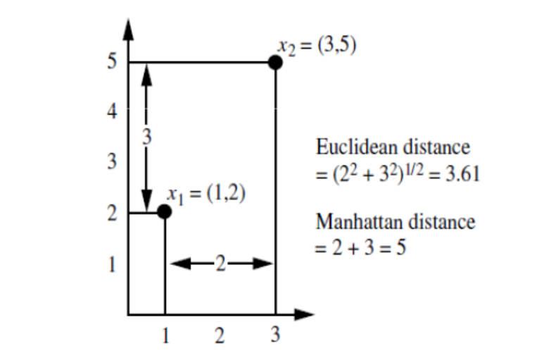

Example
Consider $x_{1}$=(1,2) and $x_{2}$=(3,5) be two objects

Slide 24
Dissimilarity Calculation

Slide 25
Binary Variables
A binary variable has only two states: 0 or 1, where 0 means that the variable is absent, and 1 means that it is present.
Given the variable smoker describing a patient,
1 indicates that the patient smokes
0 indicates that the patient does not.
Treating binary variables as if they are interval-scaled can lead to misleading clustering results.
Therefore, methods specific to binary data are necessary for computing dissimilarities

Slide 26
Dissimilarity Calculation- Binary Variables
If all binary variables are thought of as having the same weight, we have the 2-by-2 contingency table

Slide 27
Dissimilarity Calculation
A binary variable is symmetric if both of its states are equally valuable and carry the same weight
– Example: the attribute gender having the states male and female.
Dissimilarity that is based on symmetric binary
variables is called symmetric binary dissimilarity.
The dissimilarity between objects i and j is given by:

Slide 28
Asymmetric Dissimilarity
A binary variable is asymmetric if the outcomes of the states are not equally important,
– Example: the positive and negative outcomes of a HIV test.
We shall code the most important outcome, which is usually the rarest one, by 1 (HIV positive)
Given two asymmetric binary variables, the agreement of two 1s (a positive match) is then considered more significant than that of two 0s (a negative match).
The dissimilarity based on such variables is called asymmetric
binary dissimilarity

Slide 29
Asymmetric dissimilarity
In asymmetric binary dissimilarity the number of
negative matches, t, is considered unimportant and
thus is ignored in the computation

Slide 30
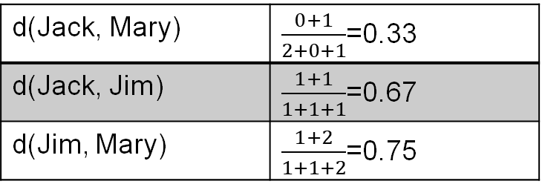
Example: Dissimilarity between asymmetric binary variables
Name | Gender | Fever | Cough | Test -1 | Test -2 | Test-3 | Test-4
Jack | M | Y | N | P | N | N | N
Mary | F | Y | N | P | N | P | N
Jim | M | Y | P | N | N | N | N
We will consider the variable other than the gender as it is a symmetric variable. We will let the values Y and P be 1 and N be 0.
Mary
Jack |  | 1 | 0 | sum
 | 1 | 2 | 0 | 2
 | 0 | 1 | 3 | 4
 | sum | 3 | 3 | 6
Jim
Jack |  | 1 | 0 | sum
 | 1 | 1 | 1 | 2
 | 0 | 1 | 3 | 4
 | sum | 2 | 4 | 6
Mary
Jack |  | 1 | 0 | sum
 | 1 | 1 | 1 | 2
 | 0 | 2 | 2 | 4
 | sum | 3 | 3 | 6
d(Jack, Mary) | $\frac{0+1}{2+0+1}$=0.33
d(Jack, Jim) | $\frac{1+1}{1+1+1}$=0.67
d(Jim, Mary) | $\frac{1+2}{1+1+2}$=0.75

Slide 31
Example: Dissimilarity Between Binary Variables
These measurements suggest that
– Mary and Jim are unlikely to have a similar disease because they have the highest dissimilarity value among the three pairs.
– Of the three patients, Jack and Mary are the most likely to have a similar disease.

Slide 32
Asymmetric binary similarity
The asymmetric binary similarity between the
objects i and j, or sim(i, j), can be computed as
The coefficient sim(i, j) is called the Jaccard
coefficient

Slide 33
Partitioning Methods
Given D, a data set of n objects, and k, the number of clusters to form
A partitioning algorithm organizes the objects into k partitions (k ≤ n), where each partition represents a cluster.
The clusters are formed to optimize an objective partitioning criterion
– such as a dissimilarity function based on distance, so that
the objects within a cluster are “similar,” whereas the
objects of different clusters are “dissimilar” in terms of the
data set attributes.

Slide 34
Types of Clusters
Well-separated clusters
Center-based clusters
Contiguous clusters
Density-based clusters
Property or Conceptual
Described by an Objective Function

Slide 35
Types of Clusters: Well-Separated
Well-Separated Clusters:
A cluster is a set of points such that any point in a cluster is closer (or more similar) to every other point in the cluster than to any point not in the cluster.
3 well-separated clusters

Slide 36
Types of Clusters: Center-Based
Center-based
A cluster is a set of objects such that an object in a cluster is closer (more similar) to the “center” of a cluster, than to the center of any other cluster
The center of a cluster is often a centroid, the average of all the points in the cluster, or a medoid, the most “representative” point of a cluster
4 center-based clusters

Slide 37
Partitioning Algorithms: Basic Concept
Partitioning method: Partitioning a database D of n objects into a set of k clusters, such that the sum of squared distances is minimized (where ci is the centroid or medoid of cluster Ci)
Given a k, find a partition of k clusters that optimizes the chosen partitioning criterion
Global optimal: exhaustively enumerate all partitions
Heuristic methods: k-means and k-medoids algorithms
k-means (MacQueen’67): Each cluster is represented by the center of the cluster
k-medoids or PAM (Partition around medoids) (Kaufman & Rousseeuw’87): Each cluster is represented by one of the objects in the cluster

Slide 38
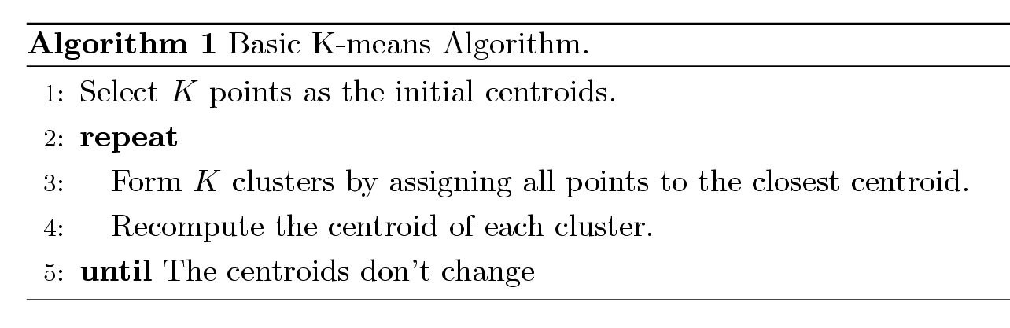
K-means Clustering
Partitional clustering approach
Number of clusters, K, must be specified
Each cluster is associated with a centroid (center point)
Each point is assigned to the cluster with the closest centroid
The basic algorithm is very simple

Slide 39
How many clusters?
Determining the optimal number of clusters is a challange
http://uc-r.github.io/kmeans_clustering
Commonly used methods
Elbow method
Silhouette method
Gap statistic

Slide 40
K-Means Clustering (contd.)
Example

Slide 41
Example
Consider the following five data points
This data set is to be grouped into two clusters. As a first step in finding a sensible initial partition, let the A & C values of the two individuals furthest apart. We could have chosen any two points from the data or any other two points.
i | x | y
A | 1 | 1
B | 1 | 0
C | 0 | 2
D | 2 | 4
E | 3 | 5

Slide 42
K-means cluster Example
Calculate the distances between each of the points and the cluster means (i.e. A and C)
Column 1 is the distance between A and each points and column 2 is distance between C and each data points.
Choose the smaller value among the distances to assign the cluster
Calculate the cluster means:
Cluster 1 mean: (1,0.5)
Cluster 2 mean: (5/3,11/3)
i | 1 | 2
A | 0 | 1.4
B | 1 | 2.2
C | 1.4 | 0
D | 3.2 | 2.8
E | 4.5 | 4.2
1 | 2
A
B
 | C
 | D
 | E

Slide 43
K-means cluster example
Calculate the distances between m1 and each points and m2 and each points
Observe that comparing the distance A,B, C belong
to cluster 1 and D and E
belong to cluster 2.
Now we have new means m1=(2/3, 1)
m2=(5/2,9/2)
i | 1 | 2
A | 0.5 | 2.7
B | 0.5 | 3.7
C | 1.8 | 2.4
D | 3.6 | 0.5
E | 4.9 | 1.9

Slide 44
K-means clustering example
Cluster 1: A, B and C
Cluster 2: D and E
There will be no new partition with further iterations.

Slide 45
K-means clustering using R
> Name=c("A","B","C","D","E")
> x=c(1,1,0,2,3)
> y=c(1,0,2,4,5)
> data=data.frame(Name, x,y)
> datanew=data[,c(2,3)]
> data.class=data[,1]
> result<- kmeans(datanew,2)
> result$size
[1] 3 2
> result$cluster
[1] 1 1 1 2 2

Slide 46
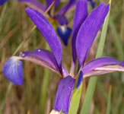
K-means clustering : iris data
This is perhaps the best known database to be found in the pattern recognition literature.
This data describes the measurements in centimeters of the variables sepal length and width and petal length and width, respectively, for 50 flowers from each of 3 species of iris. The species are Iris setosa, versicolor, and virginica.
https://archive.ics.uci.edu/ml/datasets/iris
> head(iris)
Sepal.Length Sepal.Width Petal.Length Petal.Width Species
1 5.1 3.5 1.4 0.2 setosa
2 4.9 3.0 1.4 0.2 setosa
3 4.7 3.2 1.3 0.2 setosa
4 4.6 3.1 1.5 0.2 setosa
5 5.0 3.6 1.4 0.2 setosa
6 5.4 3.9 1.7 0.4 setosa

Slide 47
Preprocessing the data
We have to subset the data such that the class labels are not included in the data
> iris.new=iris[-5]
> iris.class=iris[,5]
Normalize the data
normalize <- function(x){
return ((x-min(x))/(max(x)-min(x)))
}
iris_norm<- as.data.frame(lapply(iris.new[,c(1,2,3,4)],normalize))
head(iris_norm)

Slide 48
Apply k-means clustering
> result<- kmeans(iris.new,centers=3)
> result
> result$size
> result$centers
> result$cluster
> par(mfrow=c(2,2), mar=c(5,4,2,2))
> plot(iris.new[c(1,2)], col=result$cluster)
> plot(iris.new[c(1,2)], col=iris.class)
> plot(iris.new[c(3,4)], col=result$cluster)
> plot(iris.new[c(3,4)], col=iris.class)
#############################
> table(result$cluster,iris.class)

Slide 49
K-means clustering Iris data

Slide 50
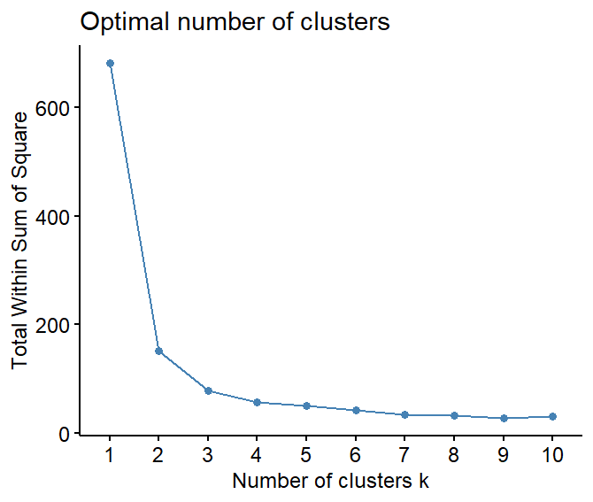
How many clusters to use?
> library(factoextra)
> fviz_nbclust(iris.new,kmeans, method="wss")

Slide 51
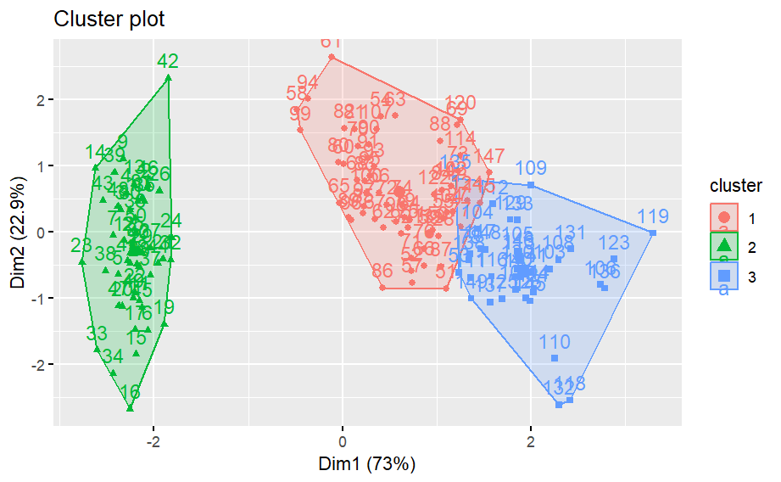
Graphical display
library(factoextra)
library(ggplot2)
fviz_cluster(result, data=iris.new)

Slide 52
Using fpc library
library(fpc)
kmeans.result <- kmeansruns(iris_norm)
Kmeans.result

Slide 53
Limitations of K-means
K-means has problems when clusters are of differing
Sizes
Densities
Non-globular shapes
K-means has problems when the data contains outliers.

Slide 54
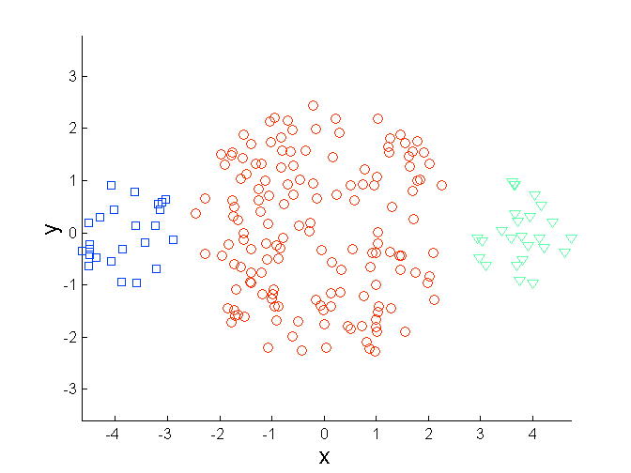
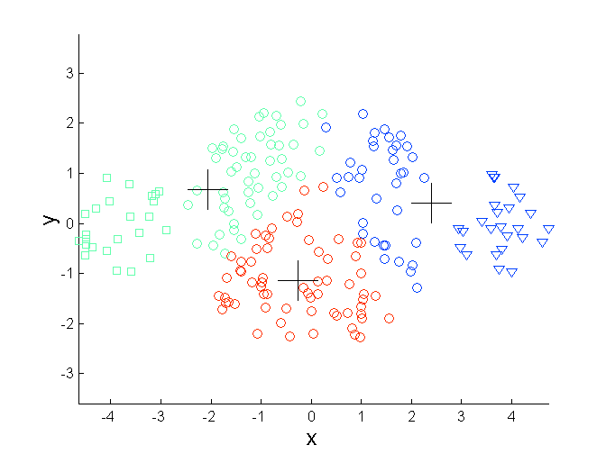
Limitations of K-means: Differing Sizes
Original Points
K-means (3 Clusters)

Slide 55
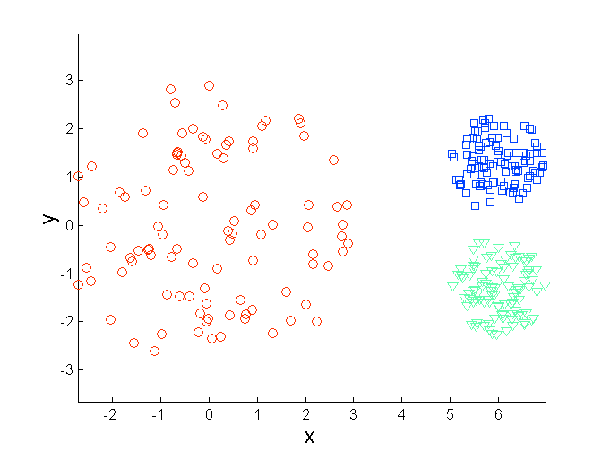
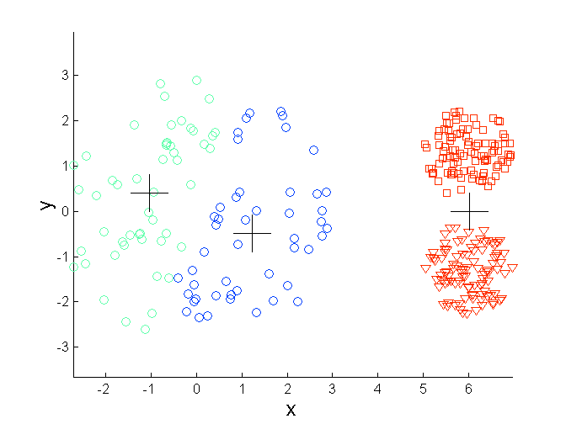
Limitations of K-means: Differing Density
Original Points
K-means (3 Clusters)

Slide 56
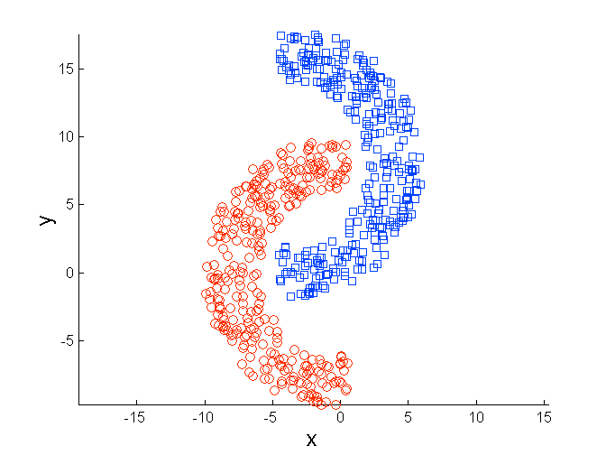
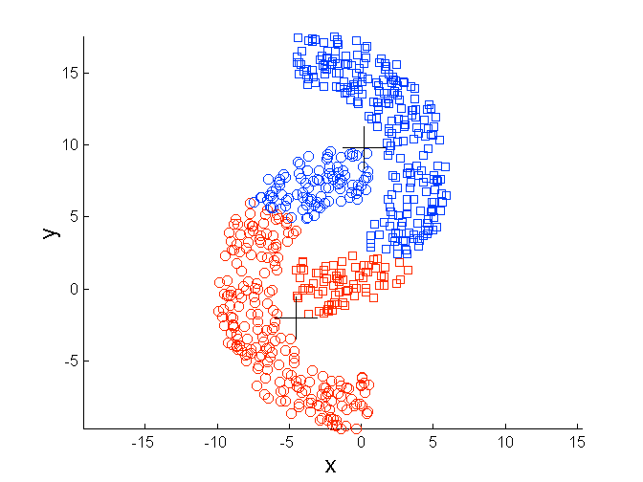
Limitations of K-means: Non-globular Shapes
Original Points
K-means (2 Clusters)

Slide 57
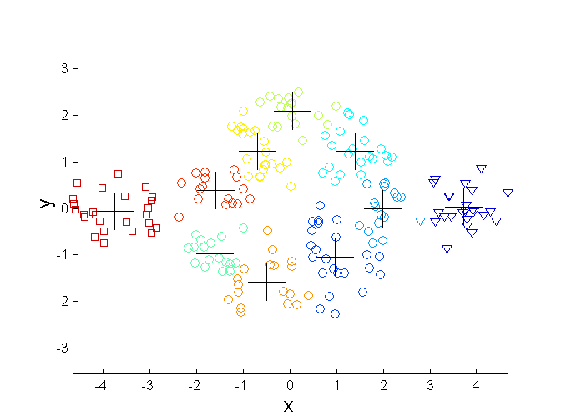
Overcoming K-means Limitations
Original Points K-means Clusters
One solution is to use many clusters.
Find parts of clusters, but need to put together.

Slide 58
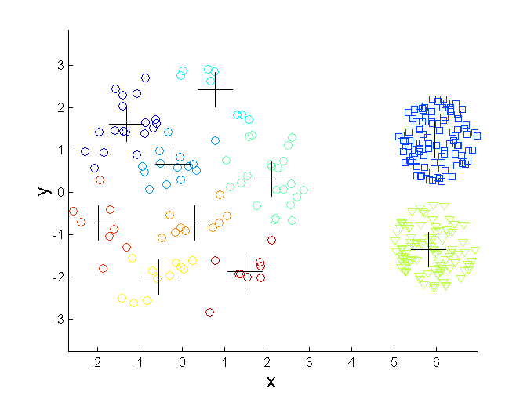
Overcoming K-means Limitations
Original Points K-means Clusters

Slide 59
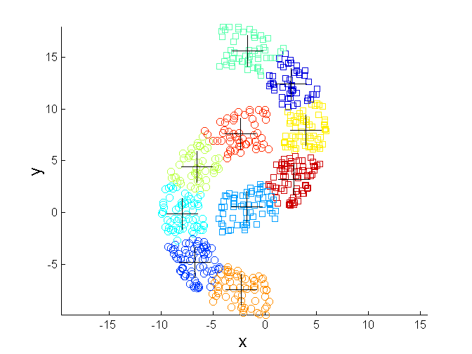
Overcoming K-means Limitations
Original Points K-means Clusters

Slide 60
Empty Clusters
K-means can yield empty clusters
Empty Cluster

Slide 61
Handling Empty Clusters
Basic K-means algorithm can yield empty clusters
Several strategies
Choose the point that contributes most to SSE
Choose a point from the cluster with the highest SSE
If there are several empty clusters, the above can be repeated several times.

Slide 62
Updating Centers Incrementally
In the basic K-means algorithm, centroids are updated after all points are assigned to a centroid
An alternative is to update the centroids after each assignment (incremental approach)
Each assignment updates zero or two centroids
More expensive
Introduces an order dependency
Never get an empty cluster
Can use “weights” to change the impact

Slide 63
k-Medoids Algorithm
k-Medoids: Instead of taking the mean value of the object in a cluster as a reference point, medoids can be used, which is the most centrally located object in a cluster.
Find representative objects, called medoids, in cluster
The partitioning method is then performed based on the principle of minimizing the sum of the dissimilarities between each object and its corresponding reference point.

Slide 64
Partitioning Around Medoids (PAM) Algorithm
Partitioning Around Medoids (PAM) is one of the first k- medoids algorithms introduced
– After an initial random selection of k representative objects, the algorithm repeatedly tries to make a better choice of cluster representatives.
– randomly select a non-representative object
– All of the possible pairs of objects are analyzed, where one object in each pair is considered a representative object and the other is not.
– The quality of the resulting clustering is calculated for each such
combination.

Slide 65
PAM Algorithm
PAM is more robust than k-means in the presence of noise and outliers because a medoid is less influenced by outliers or other extreme values than a mean
PAM works efficiently for small data sets but does not scale well for large data sets

Slide 66
K-medoid clustering
Different from k-means: a cluster is represented with its center in the k-means algorithm, but with the object closest to the center of the cluster in the k-medoids clustering.
more robust than k-means in presence of outliers
PAM (Partitioning Around Medoids) is a classic algorithm for k-medoids clustering.
The CLARA algorithm is an enhanced technique of PAM bydrawing multiple samples of data, applying PAM on each sample and then returning the best clustering. It performs better than PAM on larger data.
Functions pam() and clara() in package cluster [Maechler et al., 2016]
Function pamk() in package fpc does not require a user to choose k.

Slide 67
Clustering with PAM
> library(cluster)
# group into 3 clusters
> pam.result <- pam(iris_norm, 3)
# check against actual class label
> table(pam.result$clustering, iris$Species)
##
## setosa versicolor virginica
## 1 50 0 0
## 2 0 48 14
## 3 0 2 36
> plot(pam.result)
Cluster 1 is species “setosa” and is well separated from the other two.
Cluster 2 is mainly composed of “versicolor”, plus some cases from “virginica”.
The majority of cluster 3 are “virginica”, with two cases from “versicolor”

Slide 68
Pre-processing and Post-processing
Pre-processing
Normalize the data
Eliminate outliers
Post-processing
Eliminate small clusters that may represent outliers
Split ‘loose’ clusters, i.e., clusters with relatively high SSE
Merge clusters that are ‘close’ and that have relatively low SSE
Can use these steps during the clustering process
ISODATA(Iterative Self-Organizing Data Analysis Technique)

Slide 69
Hierarchical Clustering
Produces a set of nested clusters organized as a hierarchical tree
Can be visualized as a dendrogram
A tree like diagram that records the sequences of merges or splits

Slide 70
Types of hierarchical clustering methods
Agglomerative: the hierarchical decomposition is formed in a bottom-up (merging) fashion.
Divisive: the hierarchical decomposition is formed in a top-down (splitting) fashion

Slide 71
Agglomerative hierarchical clustering
This bottom-up strategy starts by placing each object in its own cluster and then merges these atomic clusters into larger and larger clusters, until all of the objects are in a single cluster or until certain termination conditions are satisfied.
Most hierarchical clustering methods belong to this category.
They differ only in their definition of intercluster similarity

Slide 72
Divisive hierarchical clustering
This top-down strategy starts with all objects in one cluster.
It subdivides the cluster into smaller and smaller pieces, until each object forms a cluster on its own or until it satisfies certain termination conditions,
Termination conditions can be
a desired number of clusters is obtained or
the diameter of each cluster is within a certain threshold

Slide 73
Example
Agglomerative and divisive hierarchical clustering on data objects {a, b, c, d, e}

Slide 74
A Dendrogram Shows How the Clusters are Merged Hierarchically
o Decompose data objects into a several levels of nested partitioning (tree of clusters), called a dendrogram.
o A clustering of the data objects is obtained by cutting the dendrogram at the desired level, then each connected component forms a cluster.

Slide 75
Divisive Analysis: DIANA

Slide 76
Strengths of Hierarchical Clustering
Do not have to assume any particular number of clusters
Any desired number of clusters can be obtained by ‘cutting’ the dendrogram at the proper level
They may correspond to meaningful taxonomies
Example in biological sciences (e.g., animal kingdom, phylogeny reconstruction, …)

Slide 77
Agglomerative Clustering Algorithm
Most popular hierarchical clustering technique
Basic algorithm is straightforward
Compute the proximity matrix
Let each data point be a cluster
Repeat
Merge the two closest clusters
Update the proximity matrix
Until only a single cluster remains
Key operation is the computation of the proximity of two clusters
Different approaches to defining the distance between clusters distinguish the different algorithms

Slide 78
Dendrogram
A tree structure which is commonly used to represent the process of hierarchical clustering. It shows how objects are grouped together step by step.
Dendrogram representation data objects {a, b, c, d, e}.

Slide 79
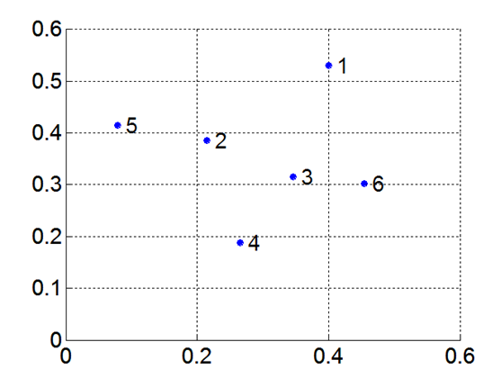
Example- Hierarchical Clustering
Find the clusters using single linkage technique
Distance Matrix
Smallest value is chosen
 | X | Y
P1 | 0.40 | 0.53
P2 | 0.22 | 0.38
P3 | 0.35 | 0.32
P4 | 0.26 | 0.19
P5 | 0.08 | 0.41
P6 | 0.45 | 0.30
 | P1 | P2 | P3 | P4 | P5 | P6
P1 | 0
P2 | 0.23 | 0
P3 | 0.22 | 0.15 | 0
P4 | 0.37 | 0.20 | 0.15 | 0
P5 | 0.34 | 0.14 | 0.28 | 0.29 | 0
P6 | 0.23 | 0.25 | 0.11 | 0.22 | 0.39 | 0

Slide 80
Example- Updating distance matrix
min(dist(P3,P6),P1)=min(dist(P3,P1), dist(P6,P1)) =min(0.22,0.23)=0.22
min(dist(P3,P6),P2)=min(dist(P3,P2), dist(P6,P2)) =min(0.15,0.25)=0.15
min(dist(P3,P6),P4)=min(dist(P3,P4), dist(P6,P4)) =min(0.15,0.22)=0.15
min(dist(P3,P6),P5)=min(dist(P3,P5), dist(P6,P5)) =min(0.28,0.39)=0.28
Now the minimum distance 0.14 is the cluster between P2 and P5
P3 P6 P2 P5
 | P1 | P2 | (P3,P6) | P4 | P5
P1 | 0
P2 | 0.23 | 0
(P3,P6) | 0.22 | 0.15 | 0
P4 | 0.37 | 0.20 | 0.15 | 0
P5 | 0.34 | 0.14 | 0.28 | 0.29 | 0

Slide 81
Updating the distance matrix
min(dist(P2,P5),P1)=min(dist(P2,P1), dist(P5,P1)) =min(0.23,0.34)=0.23
min(dist(P2,P5),(P3,P6))=min(dist(P2, (P3,P6)), dist(P5, (P3,P6)) =min(0.15,0.28)=0.15
min(dist(P2,P5),P4)=min(dist(P2,P4), dist(P5,P4)) =min(0.20,0.29)=0.20
Observe that there are two minimum values. Well in this case we go with the first matrix and will form a cluster of (P2,P5, P3,P6)
 | P1 | (P2,P5) | (P3,P6) | P4
P1 | 0
(P2,P5) | 0.23 | 0
(P3,P6) | 0.22 | 0.15 | 0
P4 | 0.37 | 0.20 | 0.15 | 0

Slide 82
Updating Distance Matrix
min[dist((p2,P5),(P3,P6)),P1]
= min[dist((P2,P5),P1), dist((P3,P6),P1)]
=min[0.23,0.22]
=0.22
min[dist((p2,P5),(P3,P6)),P4]
= min[dist((P2,P5),P4), dist((P3,P6),P4)]
=min[0.20,0.15]
=0.15
Now, P4 and (P2,P3,P5 P6) form a cluster.
 | P1 | P2,P3,P5,P6 | P4
P1 | 0
P2,P3,P5,P6 | 0.22 | 0
P4 | 0.37 | 0.15 | 0

Slide 83
Updating Distance matrix
min[dist(P2,P3,P5,P6),P1), dist(P4,P1)]
=min(0.22, 0.37)
=0.22
 | P1 | P2,P3,P4,P5
P1 | 0
P2,P3,P4,P5,P6 | 0.22 | 0

Slide 84
Example-Use R
> x=c(0.4,0.22,0.35,0.26,0.08,0.45)
> y=c(0.53,0.38,0.32,0.19,0.41,0.30)
> Item=c("P1","P2","P3","P4","P5","P6")
> df=data.frame(x,y,Item)
> df
x y Item
1 0.40 0.53 P1
2 0.22 0.38 P2
3 0.35 0.32 P3
4 0.26 0.19 P4
5 0.08 0.41 P5
6 0.45 0.30 P6

Slide 85
> d=dist(as.matrix(df[,-3]))
> hc <- hclust(d)
> plot(hc)

Slide 86
Hierarchical Clustering
5
1
3
5
2
1
2
3
6
4
4
Nested Clusters
Dendrogram

Slide 87
Example-Iris data
> data(iris)
> iris2 <- iris[,-5]
> d_iris <- dist(iris2, method="euclidean")
> hc_iris <- hclust(d_iris, method = "complete")
> plot(hc_iris)
##################################################
iris_species <- rev(levels(iris[,5]))
library(dendextend)
library(colorspace)
dend <- as.dendrogram(hc_iris)
dend <- rotate(dend, 1:150)
dend <- color_branches(dend, k=3)
labels_colors(dend) <-
rainbow_hcl(3)[sort_levels_values(
as.numeric(iris[,5])[order.dendrogram(dend)]
)]
labels(dend) <- paste(as.character(iris[,5])[order.dendrogram(dend)],
"(",labels(dend),")",
sep = "")
dend <- hang.dendrogram(dend,hang_height=0.1)
dend <- set(dend, "labels_cex", 0.5)
par(mar = c(3,3,3,7))
plot(dend,
main = "Clustered Iris data set
(the labels give the true flower species)",
horiz = TRUE, nodePar = list(cex = .007))
legend("topleft", legend = iris_species, fill = rainbow_hcl(3))

Slide 88
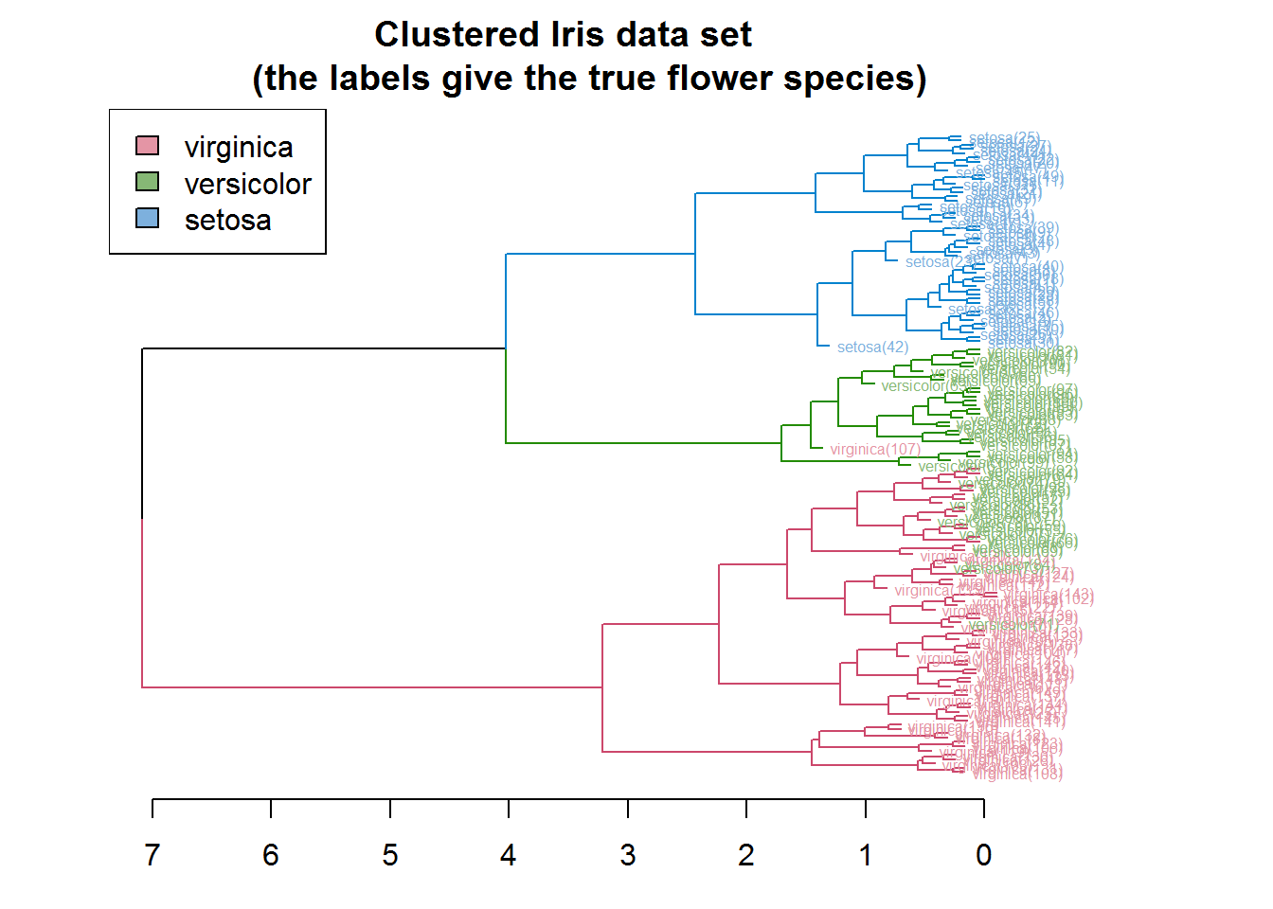
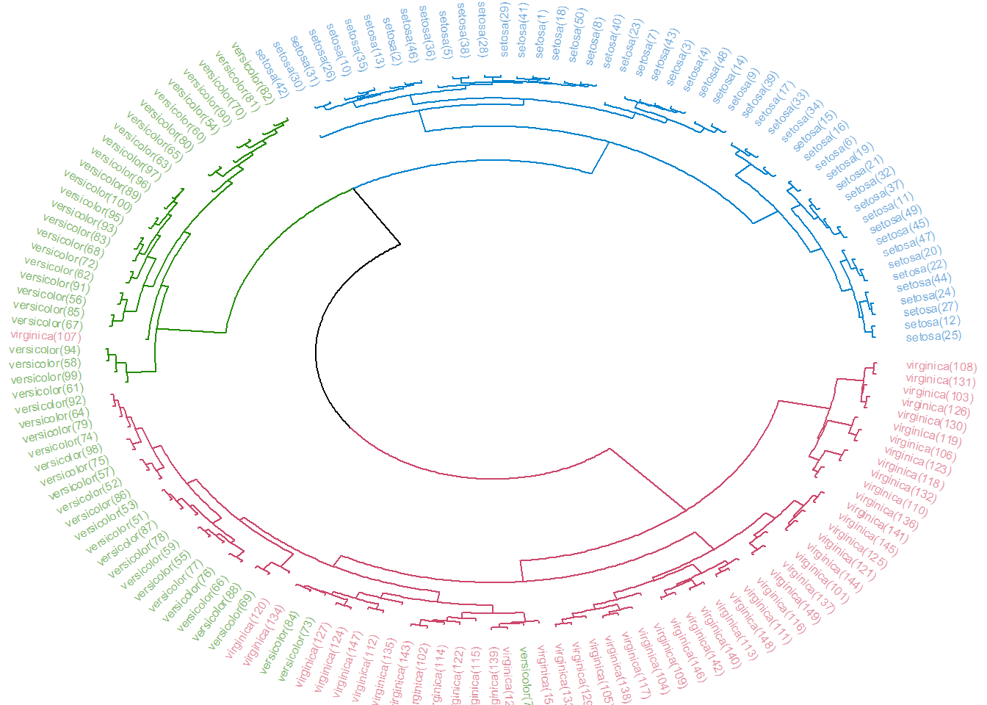
library(circlize)
par(mar = rep(0,4))
circlize_dendrogram(dend)
http://www.ams.med.uni-goettingen.de/download/Steffen-Unkel/cluster1.html

Slide 89
Final Comment on Cluster Validity
“The validation of clustering structures is the most difficult and frustrating part of cluster analysis.
Without a strong effort in this direction, cluster analysis will remain a black art accessible only to those true believers who have experience and great courage.”
Algorithms for Clustering Data, Jain and Dubes

Slide 90
References
Introduction to Data Mining
by Pang-Ning Tan, Michael Steinbach,
Anuj Karpatne and Vipin Kumar
http://www.ams.med.uni-goettingen.de/download/Steffen-Unkel/cluster1.html

Slide 91
Thank you

